Slide 1
























































Slide 2








































































Slide 3
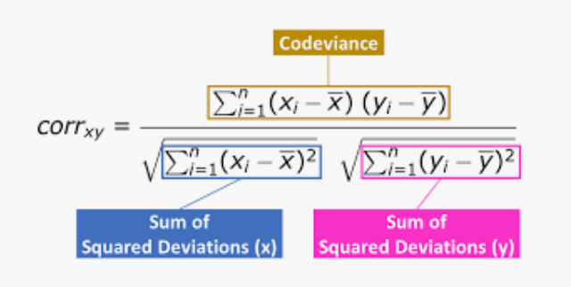



Pearson correlation coefficient

Slide 4
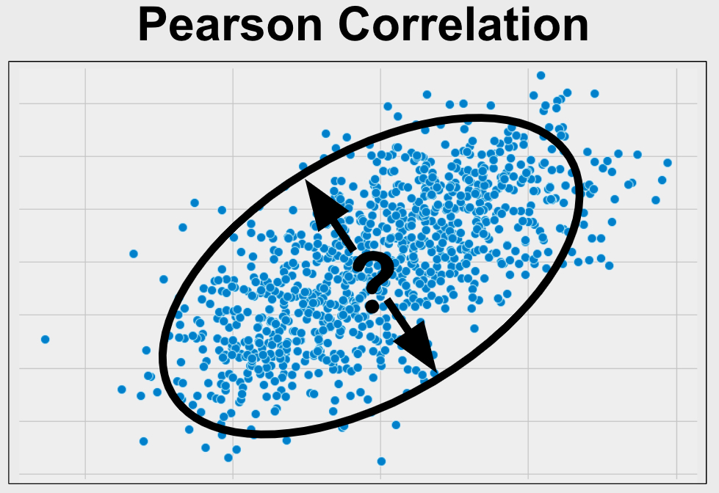








Slide 5
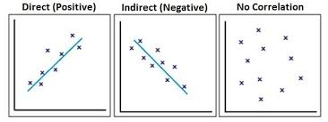





Slide 6
























Slide 7
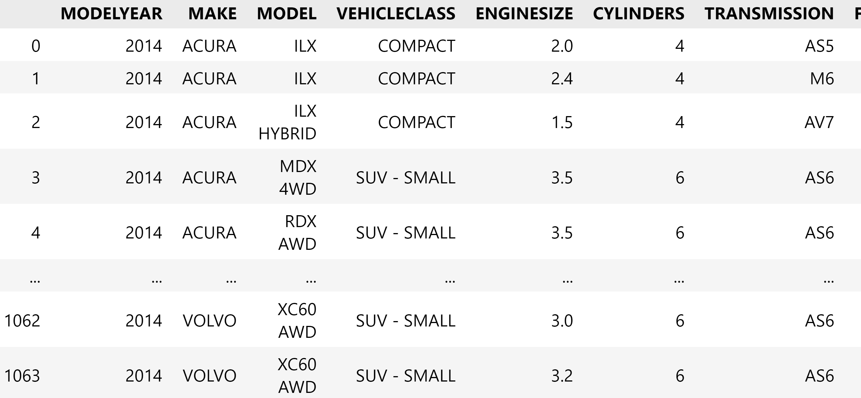






















Slide 8




































Slide 9











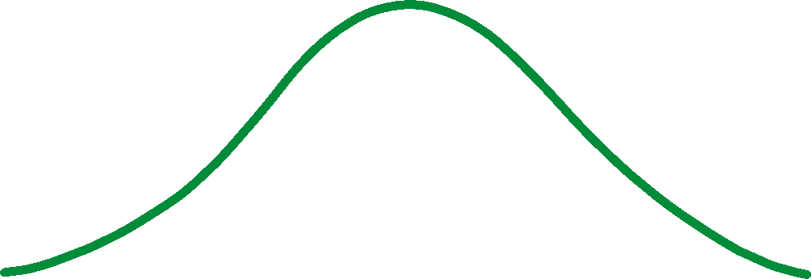











Slide 10































Slide 11








